Slide 1
Medical Appointment No Shows
Lucas Quinlan
Angel Conde
Joel Ortega
Joseph Yiga

Slide 2
Why is studying medical appointment attendance important?

Slide 3

Missed Appointments, Missed opportunities: Tacklin The Patient No-Show Problem
… “no-shows” cost the U.S. health care system more than $150 billion a year.
For individual Physicians the ¨no-shows” cost $200 per unused time slot. After all, medical practices still have to pay their staffs and cover expenses like rent and the cost of equipment.
Sachin H. Jain. Forbes

Slide 4

No-show effect: Even one missed appointment risks retention.
For patients ages 31-45, 46-60, and 61-plus with one or more “no-shows”, compared to their pairs no “no-shows”, their attrition rate went up to 57, 63, and 73 percent respectively.
Patients suffering from chronic illnesses are at a high risk. The study shows it’s harder for them to return after the first missing appointment.
Chris Hayhurst. Athenahealth

Slide 5
Each appointment taken and missed, represents a person with a health issue that could not be addressed at that moment.

Slide 6
The project
Goal: For our project we want to use the dataset to explore factors that contribute to missed appointments, and try to develop a model to predict patients that would be at risk of missing appointments.
Dataset: Medical Appointment No Shows
14 variables associated with 110,527 medical appointments.
Patient ID,
GenderAge,
Day of Appointment,
Day Appointment was Scheduled,
Neighborhood,
Presence of Various Known Pre-existing conditions,
Appointment Reminder Sent, and Outcome

Slide 7
Data Cleaning and Pre Processing
A quick overview of the steps taken to ensure our data set was of sufficient quality and suitable for the prompt:
Some heat maps and bar charts were utilised to identify through visual representation, the distribution of missing values
Examples of dropped columns included the Appointment ID column and dates.
Outlier detection was also incorporated using visualizations and they were dropped.

Slide 8
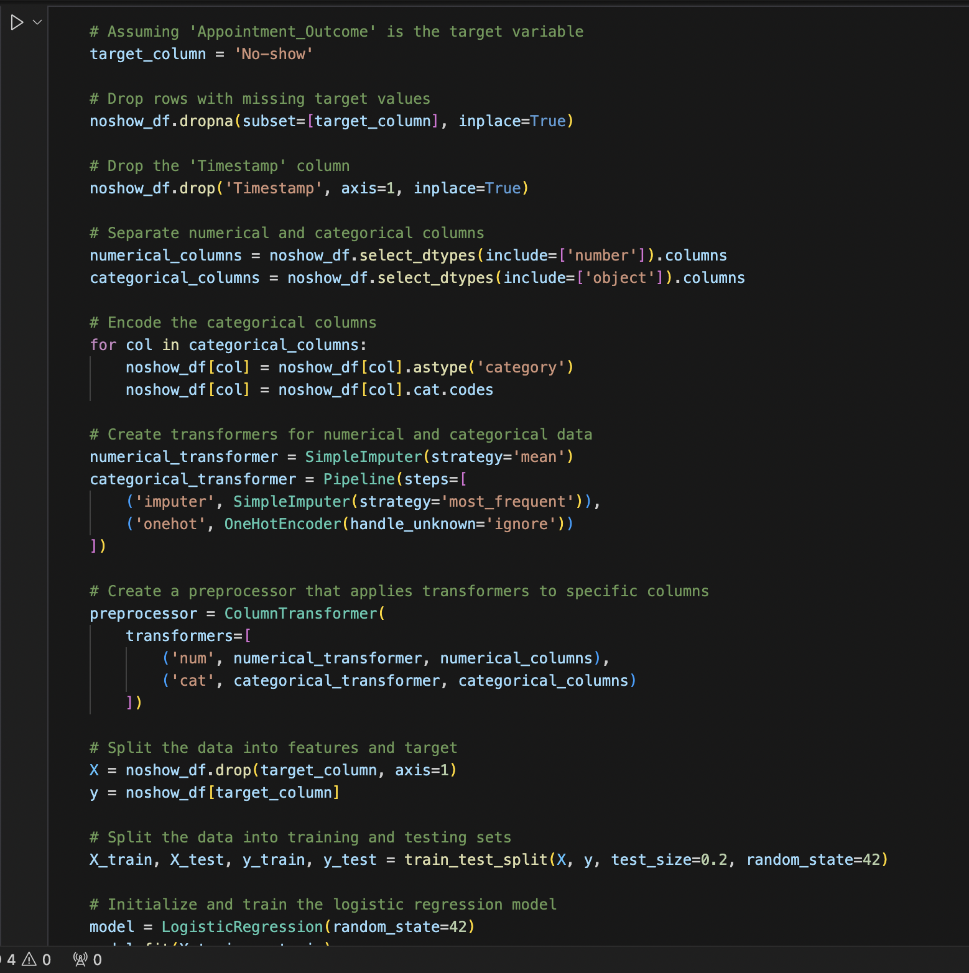
Handling of categorical variables
We identified the categorical columns in the data set as the ones with objects
We utilised one-hot encoder as it was the ideal encoder for this particular data set which included nominal data in no inherent order
Utilising one-hot encoder for this particular data set would also drive interpretability

Slide 9
Exploratory Data Analysis - EDA
EDA is conducted to understand the structure of data and assist in model/ feature selection for the machine learning algorithm
Key component of EDA is the use of histograms to showcase distribution of relevant variables, showing skewness, and spread.
The median position in the box plots for example, helped identify the skewness of the data set
EDA helped us identify anomalies not obvious in the raw data

Slide 10
Model Implementation and Optimization
Utilizing Logistic Regression based on the specifics of the data set, we were able to initialize, train and evaluate the predictive model
Preprocessing techniques were utilised to ensure the data was ready for training.
In the metrics selection process, one of the factors considered involved minimizing false positives, and this encouraged precision
One of the limitations we came across was the sensitivity of the Linear Regression Model to outliers and this leads to bias, and also in the event that the variables we utilised did not have a linear relationship, this specific model would not be utilised.
Iterative changes to the code were carried out to optimize the model.
Examples include; feature engineering (inputting or dropping columns), using different Encoders
One of our models involved neural networks, a step in the process optimization process involved adjusting the number of layers in each test

Slide 11
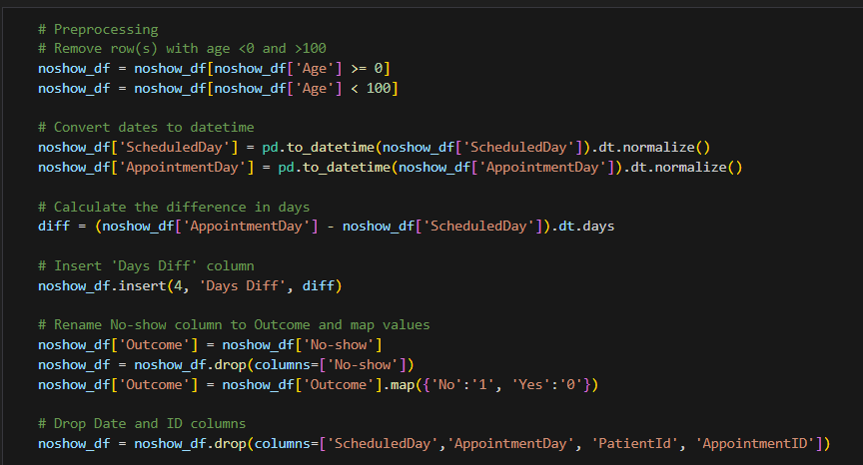
Preprocessing and Data Engineering
Removed outliers
Created new column for number of days between when the appointment was scheduled and when the appointment occurred
Mapped target outcome to numeric values
Removed patient/appointment ID columns

Slide 12
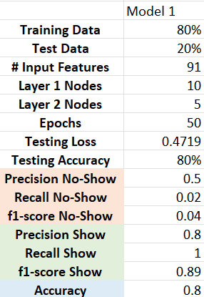
Neural Net - 1st Attempt
Used all features from preprocessing
One-hot encoded categorical features
80% used for training, 20% for testing
2 layers and 50 epochs
Good accuracy, but poor precision and recall for No-Show predictions

Slide 13
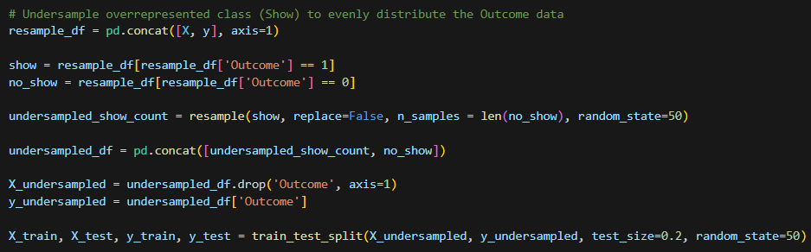
Neural Net
Our target outcomes distribution was largely imbalanced
80% Show
20% No-Show
To fix this we used an undersampling technique to balance the dataset
This did however decrease our dataset from 110,515 rows to 44,632

Slide 14
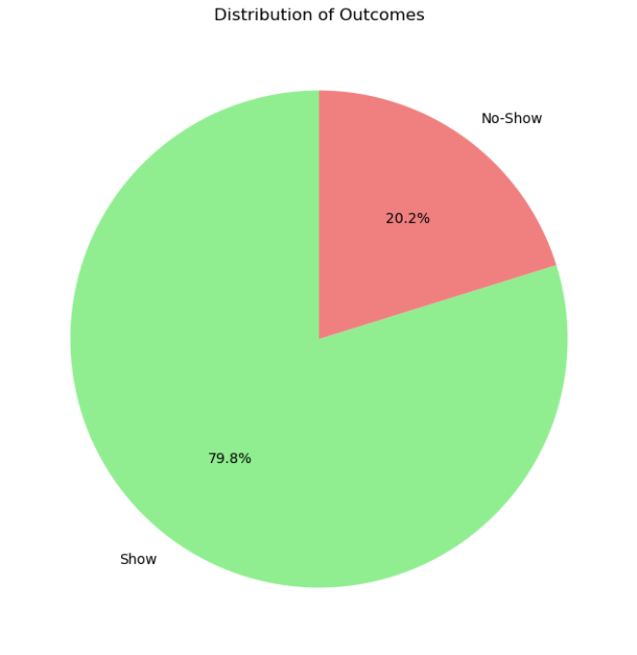
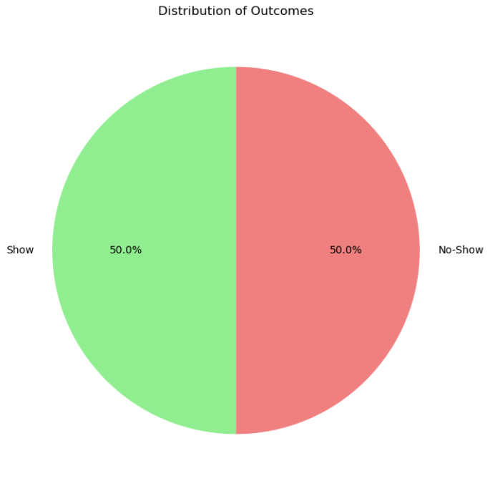
Neural Net
Before
After

Slide 15
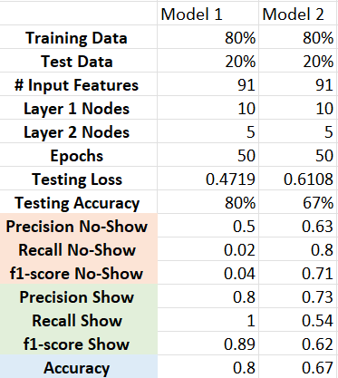
Neural Net - 2nd Attempt
Used all features from preprocessing
One-hot encoded categorical features
Balanced target outcome using undersampling technique
80% used for training, 20% for testing
2 layers and 50 epochs
Much more even Precision and Recall scores between outcomes, but a decrease in Accuracy

Slide 16
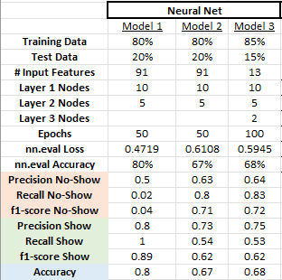
Neural Net - 3rd Attempt
Explored additional preprocessing steps:
Added columns for day of week for the appointment, and when it was scheduled
Mapped Gender and Neighborhood columns to numeric values
Added column to generate a score of comorbidities present
Increased training data to 85%
Added 3rd hidden layer
Increased epochs to 100
Saw a small increase in accuracy

Slide 17
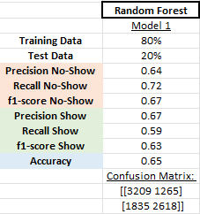
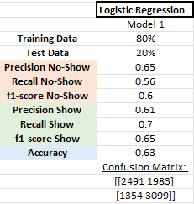
Random Forest and Logistic Regression
Used the same preprocessed data as final neural net model
Similar accuracy, precision, and recall as neural net model

Slide 18
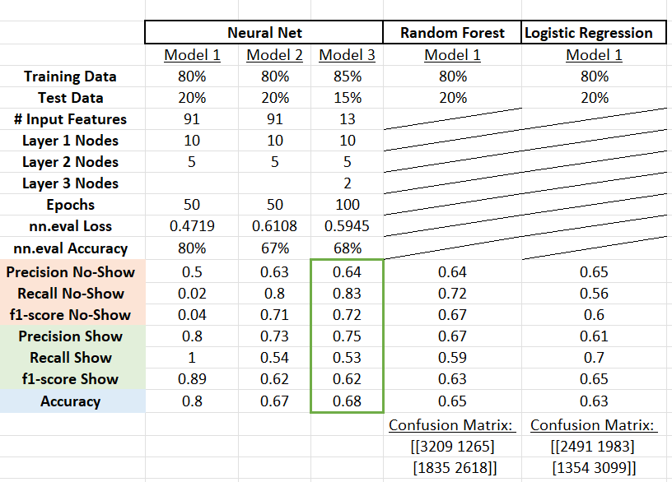
Model Comparison
Model with best overall performance was the neural net with the additional engineered features

Slide 19
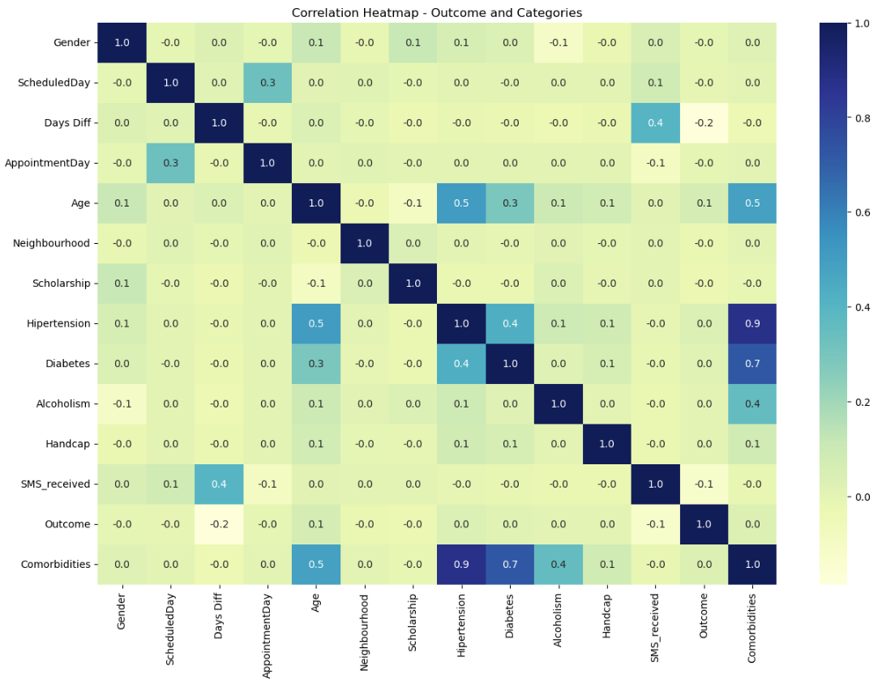
Outcome & Different Categories

Slide 20
Reasons for No-Show
Patients commonly give several reasons for missing appointments that include forgetfulness, confusion, or miscommunication over appointment information, feeling better, transportation issues, and difficulty leaving work or school.

Slide 21
Conclusion
If our model could be trained, optimized, and improved, we would be able to predict, base on the patient’s characteristics, who is more likely to miss their appointment and take appropriate measures to reduce the risk of no-shows. This could help to decrease monetary losses and improve people’s health.

Slide 22
The end

